Slide 1

MIMIC NLP
William Chung

Slide 2

Agenda
NER w/ Spacy and SciSpacy
Word2Vec
TSNE

Slide 3
Focus of assignment
For this assignment, I chose to focus on Pneumonia which has ICD9 code 486.
This is a wildly common disease that affects many people and can be a life-threatening condition for patients that are in the ICU.
I will be analyzing the discharge summary notes regarding Pneumonia using Spacy, SciSpacy, Word2Vec and TSNE plots.
There are about 5357 samples with discharge summary notes related to Pneumonia which is a far too many so we will sample the first 100 notes.

Slide 4
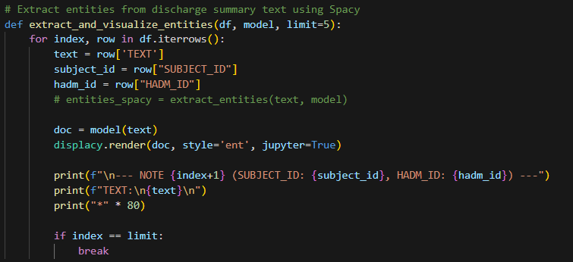
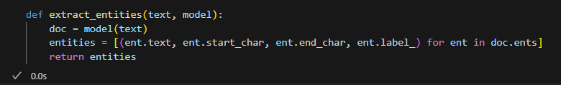
NER using spacy and scispacy
NER, named entity extraction, is a NLP technique used to identify and classify certain entities from a text. In this case, our objective is to find and extract the entities that are relevant to Pneumonia.
We will be using spaCy which is a NLP library that can do NER and also SciSpaCy which a version of spaCy that is trained on science and medical words.
Below are some functions that are useful for us.

Slide 5
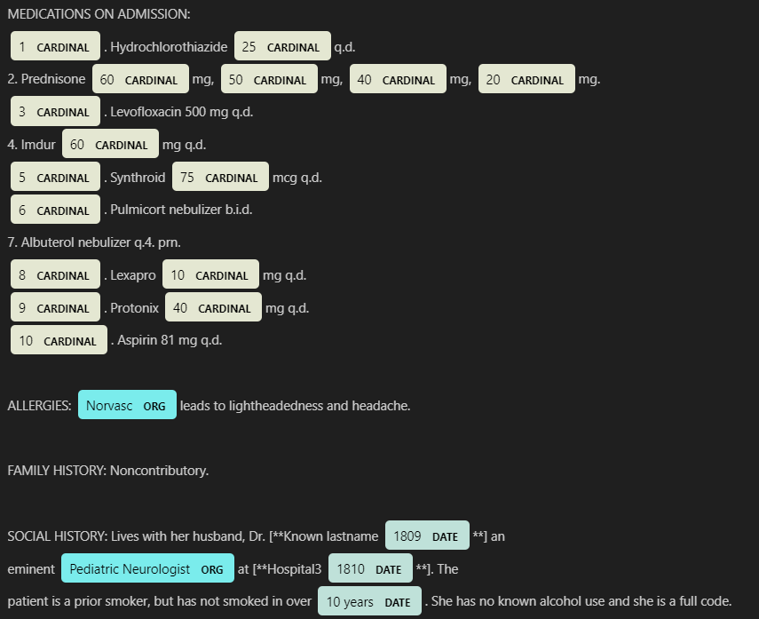
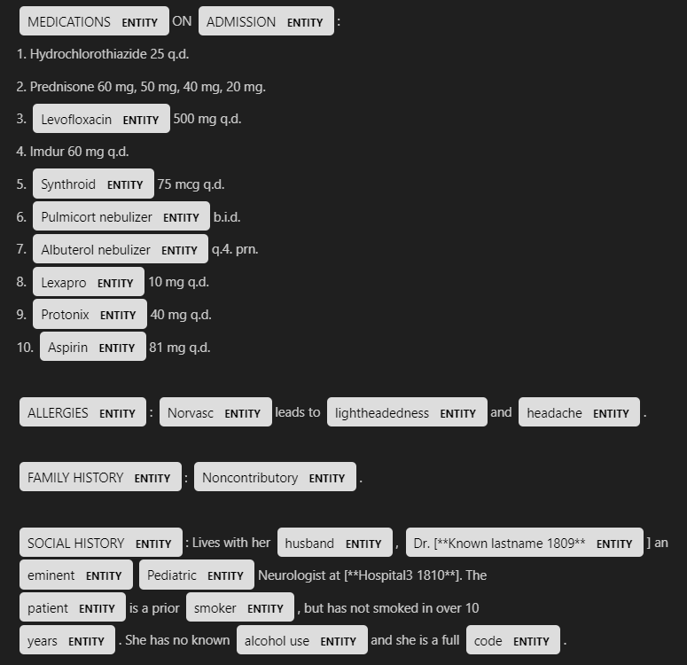
Spacy vs scispacy
We can see that SciSpaCy on the right was able to recognize many more medical terms as entities compared to spaCy on the left.

Slide 6
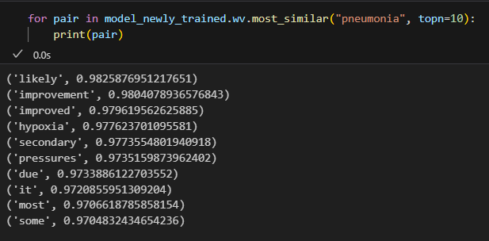
Word2vec
Word vectors is another NLP technique that is used to find similarities between words.
We will be using two different version of the Word2Vec from GenSim, pretrained vs. untrained.
Below shows our freshly trained Word2Vec with the words from the discharge summaries regarding Pneumonia and shows the top ten most similar words to “pneumonia”.

Slide 7
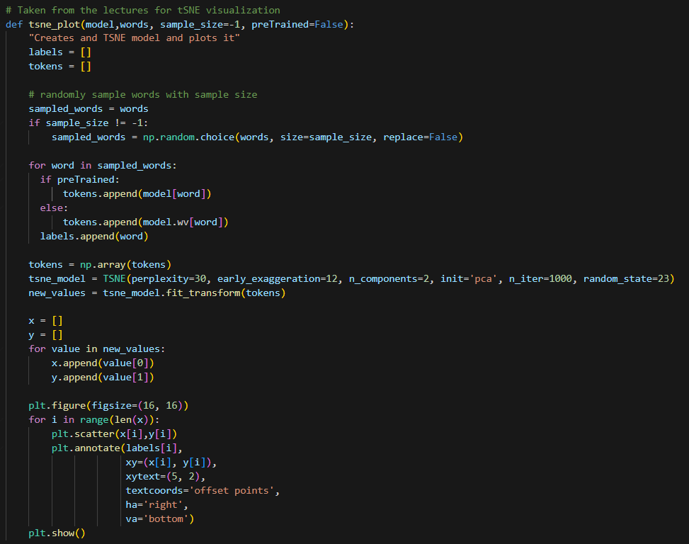
TSNE
TSNE plots are a way of visualizing the word similarities from word2vec embeddings.
For this assignment, we used the TSNE plotting code from the lectures slightly augmented with sample size to limit the amount of info we see which helps to better the visualizations.

Slide 8
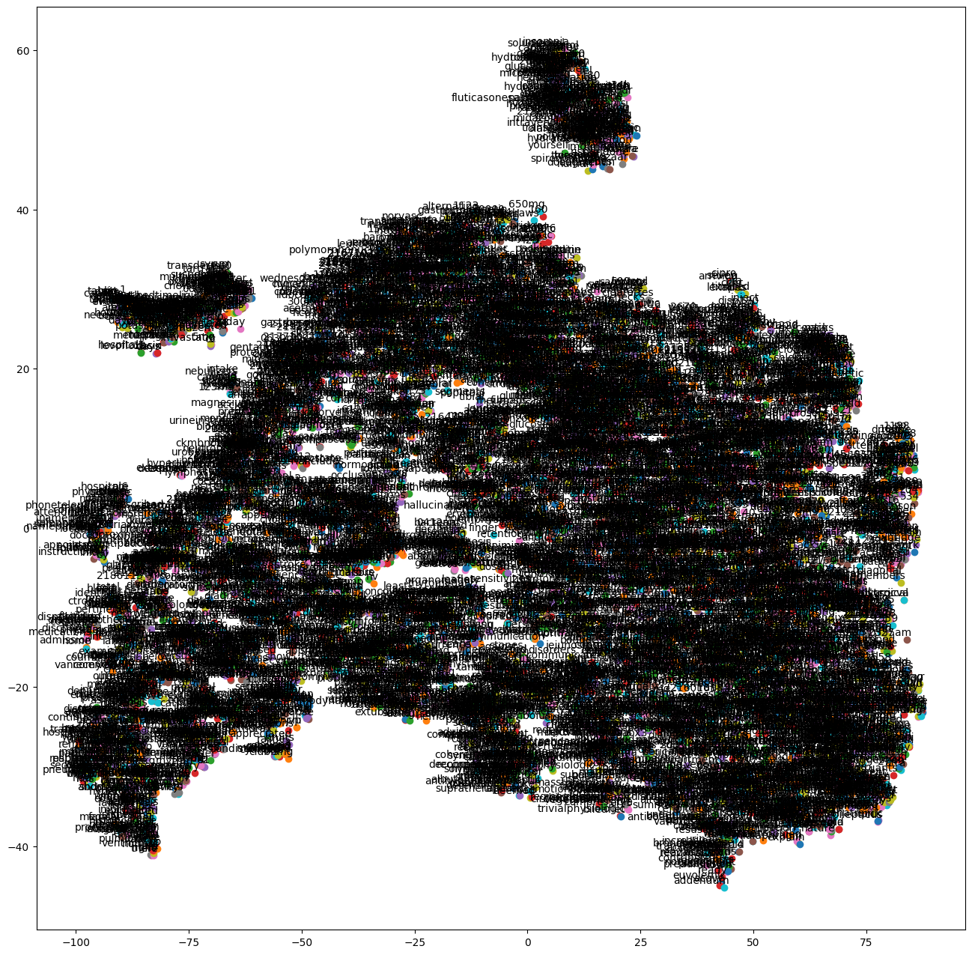
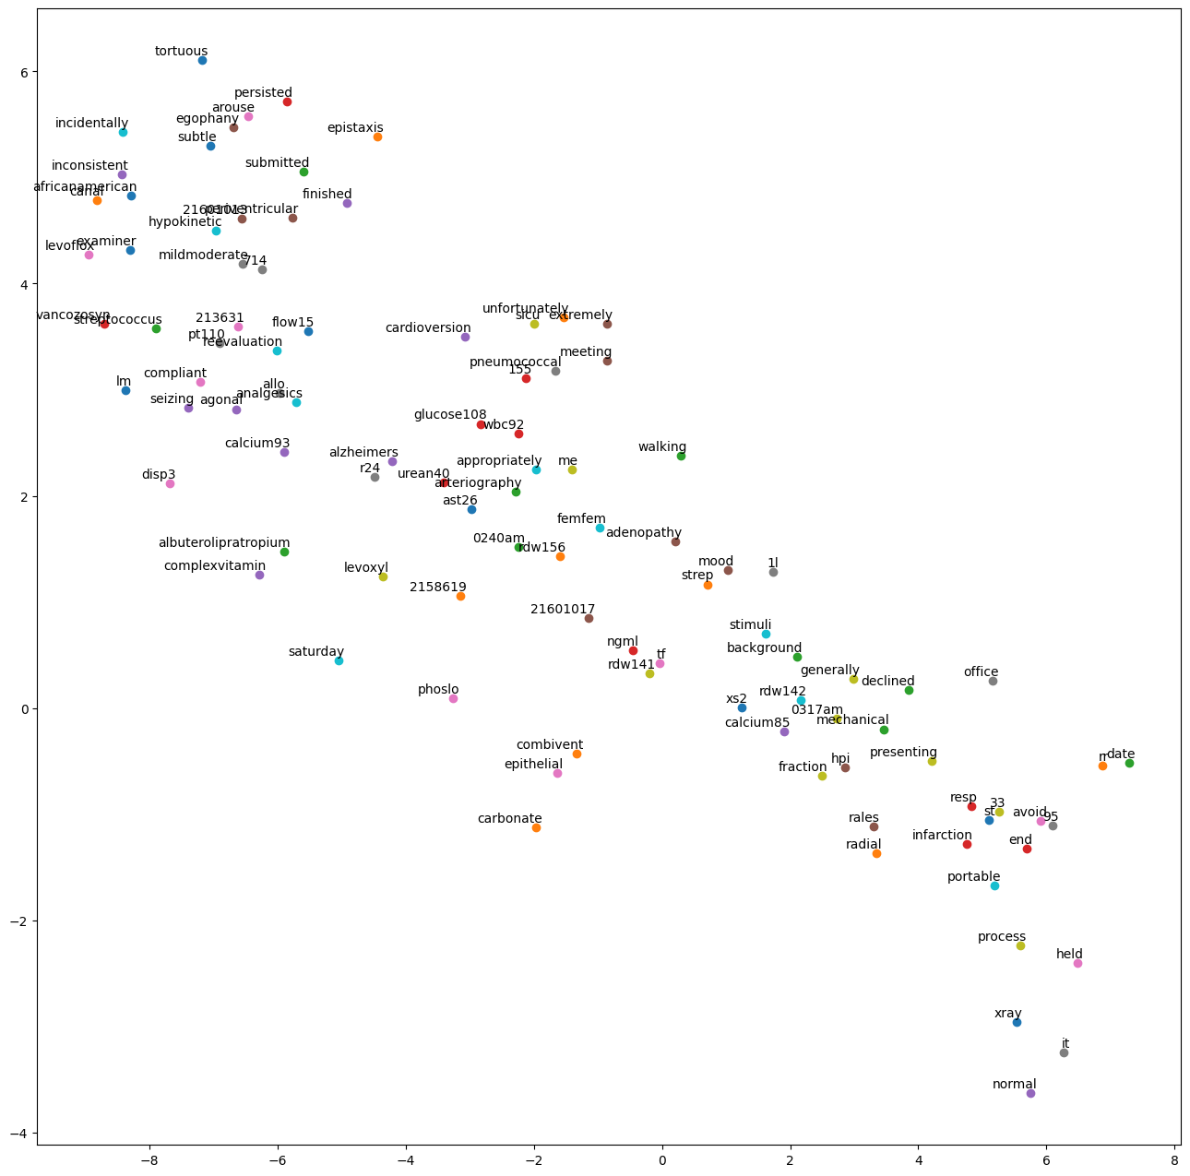
TSNE plot with and without sampling
Without sampling, there are far too many words to make any meaningful analysis
The one on the right shows the relationship between the top 100 words.

Slide 9
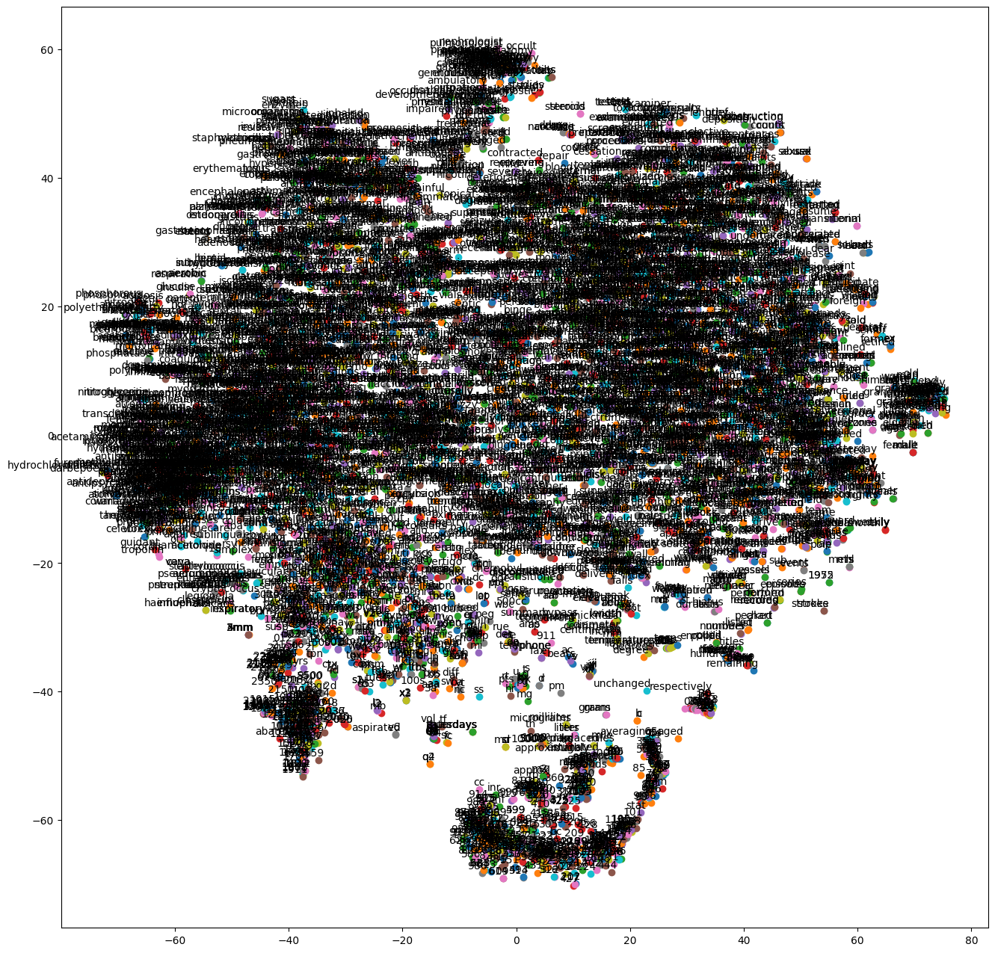
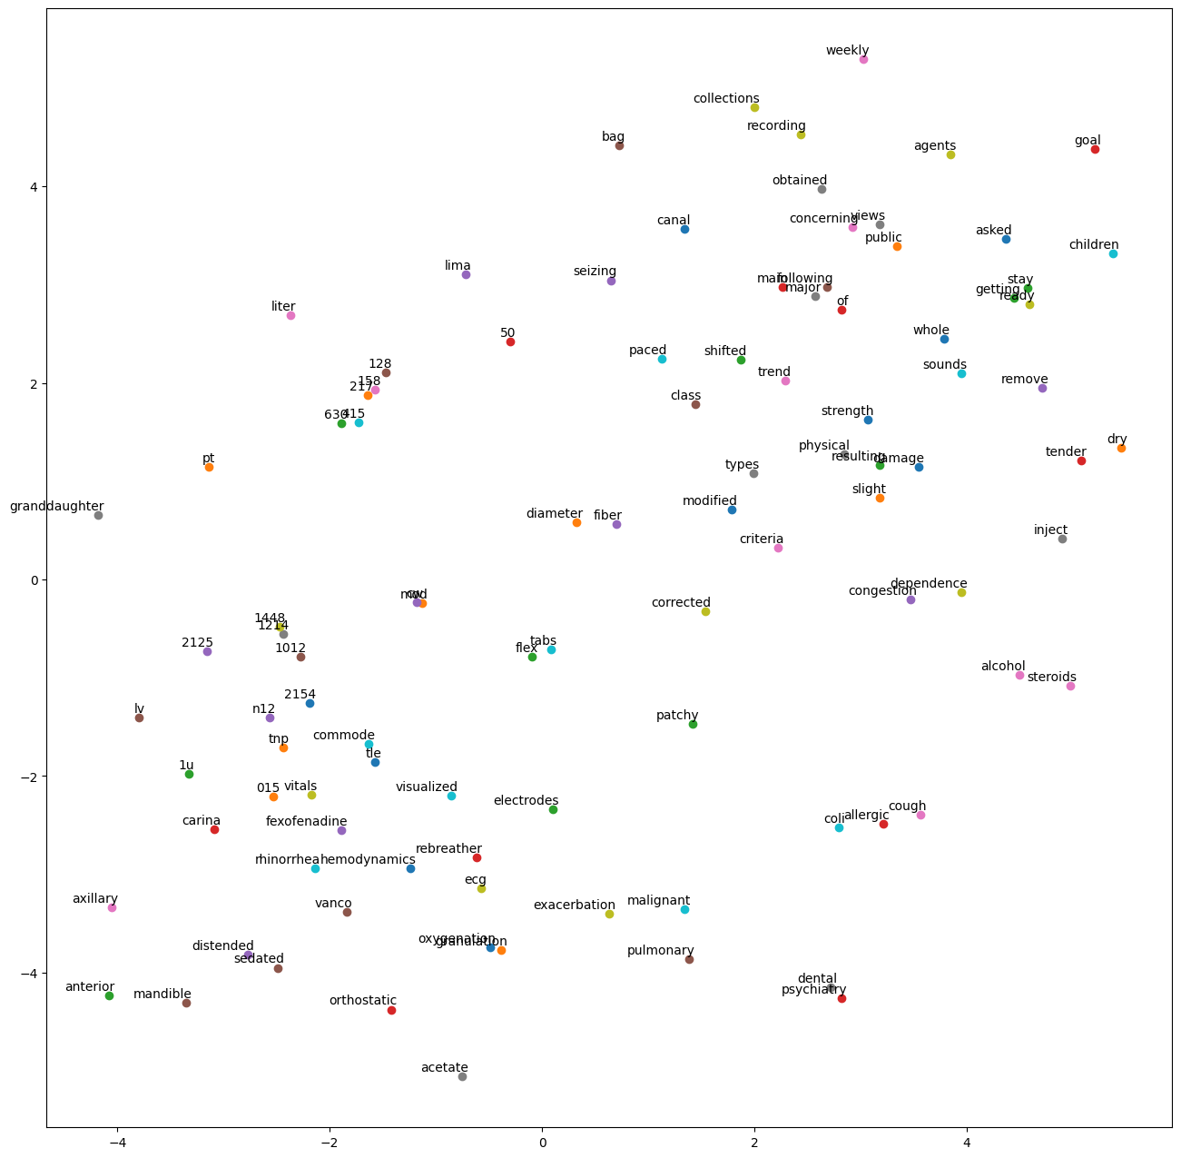
TSNE Plot With and Without sampling (pretrained)
Here we used the pretrained Word2Vec on GLOVE.

Slide 10
Resources
From the lectures:
Word2VECandtSNE.ipynb
NLP.ipynb
https://spacy.io/
https://radimrehurek.com/gensim/models/word2vec.html
MIMIC III Dataset

